Slide 1
VAED in the USA
Author: Fabian Spieker
me@pervaers.com
substack.com/@covdata
January 12, 2024
Q3/2021: A Mass Vaccine Casualty Event?

Slide 2
What is VMED/VAED?
VMED = Vaccine-Mediated Enhanced Disease
VAED = Vaccine-Enhanced Disease
Known Mechanisms
Th2-biased cellular immune response (diminished response against intracellular pathogens)
Antibody-binding can allow a number of pathogens to enter leucocytes through Fc receptors (ADE = antibody-dependent enhancement)
Unknown Mechanisms
Any vaccine-mediated effect that enhances infections

Slide 3
I. Maternal Deaths
Author: Fabian Spieker
me@pervaers.com
substack.com/@covdata
January 12, 2024

Slide 4
A “maternal death” is the death of a pregnant woman, a woman who is giving birth or one who has given birth less than 42 days ago.
Mary Beth Pfeiffer, Pierre Kory and Naomi Wolf have recently reported on an increase in U.S. maternal deaths throughout 2021 and found these excess deaths to have been attributed to COVID-19.
Source: CDC WONDER
Source: CDC WONDER

Slide 5
Source: CDC WONDER
Source: CDC WONDER

Slide 6
Source: CDC WONDER

Slide 7
Source: CDC WONDER

Slide 8
Source: CDC WONDER

Slide 9
Source: CDC WONDER

Slide 10
Maternal Deaths in the USA
Surplus in maternal mortality largely attributed to COVID-19
No vaccination data available for pregnant women
Maternal COVID mortality manifested during times when pregnant women presumably received a lot of first doses.
Are first doses increasing the risk of dying a COVID death in a time-dependent manner?
Can such an effect be observed in the general population?

Slide 11
II. COVID-19 Mortality Trends
Author: Fabian Spieker
me@pervaers.com
substack.com/@covdata
January 12, 2024

Slide 12
Pneumonia Excess Mortality vs. COVID Mortality Trends
Source: CDC WONDER
Pneumonia Excess Mortality
Source: CDC WONDER

Slide 13
Pneumonia Excess Mortality vs. COVID Mortality Trends
Source: CDC WONDER
COVID Mortality Trends
Source: CDC WONDER

Slide 14
Source: CDC WONDER

Slide 15
Source: CDC WONDER

Slide 16
Source: CDC WONDER

Slide 17
Source: CDC WONDER

Slide 18
Changing Age Structure of COVID Decedents Throughout 2021
Highest decrease in the highest age tier
Highest increase in the lowest age tier
Were age tiers that received more first doses throughout the summer of 2021 also seeing higher increases in COVID mortality?

Slide 19
III. The Link between First Doses and COVID-19 Mortality
Author: Fabian Spieker
me@pervaers.com
substack.com/@covdata
January 12, 2024

Slide 20
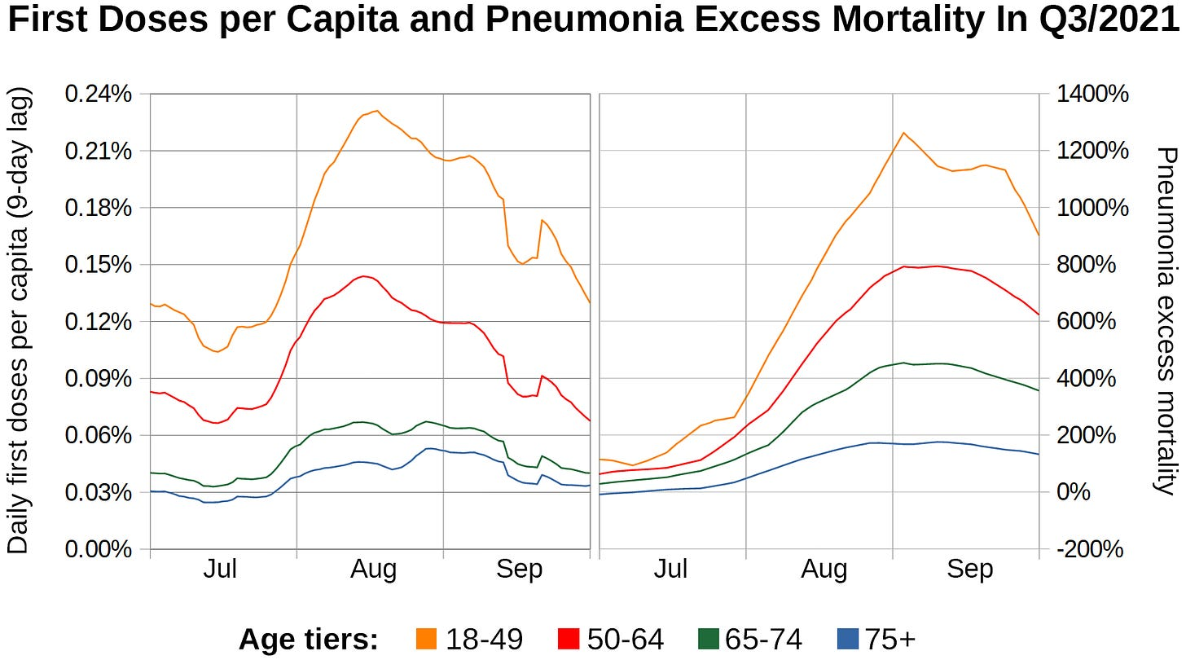
Sources: CDC WONDER and CDC Daily Vaccination Dataset

Slide 21
Sources: CDC WONDER and CDC Daily Vaccination Dataset
The more first doses were administered to an age group,
the higher the pneumonia excess mortality rate was,
peaking at over 13x the normal rate in adults under 50.

Slide 22
Sources: CDC WONDER and CDC Daily Vaccination Dataset
Sources: CDC WONDER and CDC Daily Vaccination Dataset

Slide 23
Sources: CDC WONDER and CDC Daily Vaccination Dataset
Sources: CDC WONDER and CDC Daily Vaccination Dataset
First doses precede Pneumonia deaths by roughly 2 weeks!

Slide 24
Sources: CDC WONDER and CDC Daily Vaccination Dataset
August, 2021
First doses precede Pneumonia deaths by roughly 2 weeks!
Comparison of COVID deaths and first doses in August, 2021

Slide 25
Does this Apply to Regional Differences in COVID-19 Mortality?
1. THE VISUAL APPROACH
Map 1: First doses per capita in August, 2021
Map 2: COVID deaths per capita in August, 2021

Slide 26
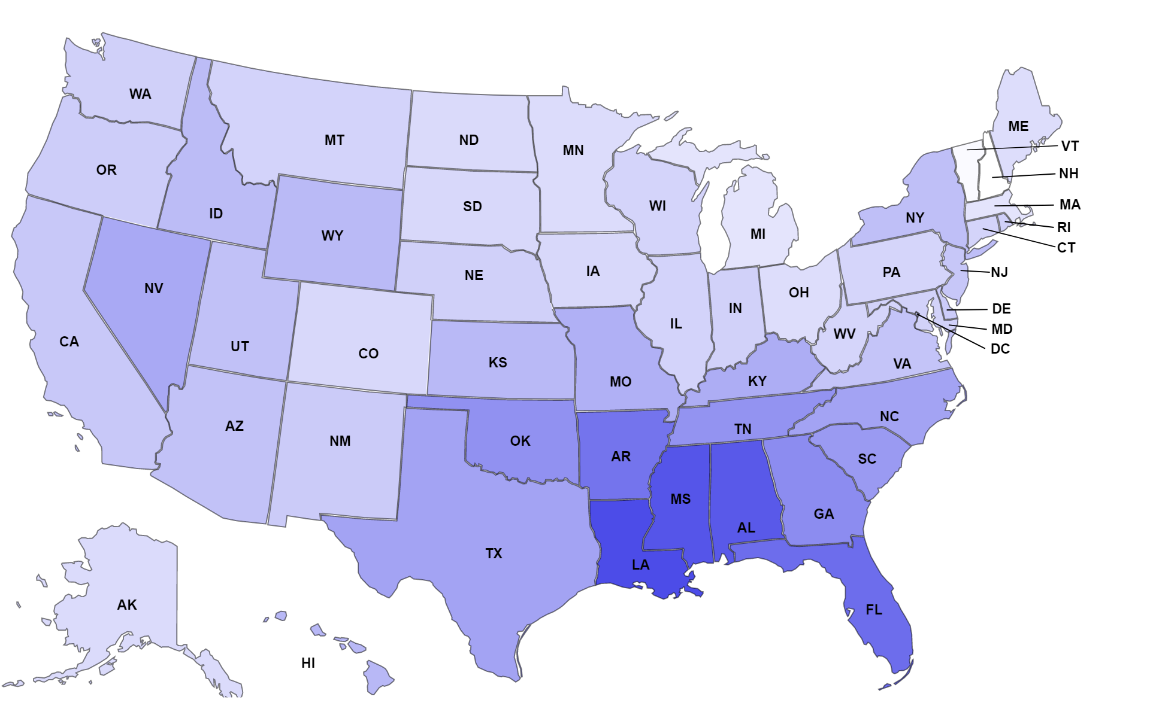
First Doses per Capita in August, 2021

Slide 27
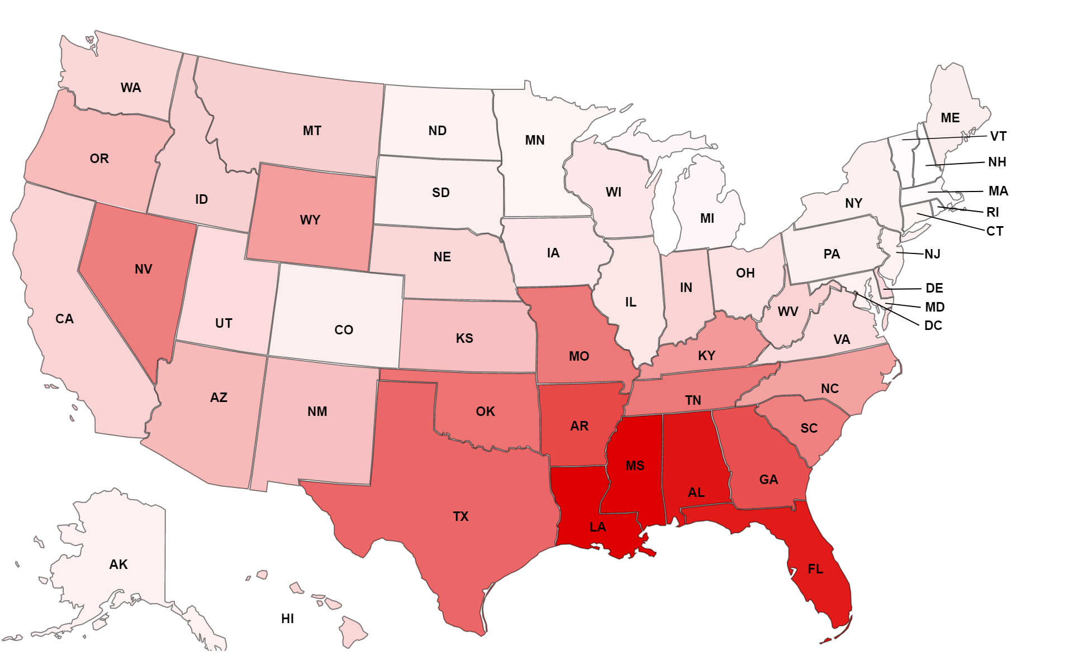
COVID Deaths per Capita in August, 2021

Slide 28
Does this Apply to Regional Differences in COVID-19 Mortality?
2. THE MATHEMATICAL APPROACH
Linear relationships between two variables across units of observation (states) can indicate causal relationships.
The strength of a linear relationship can be calculated

Slide 29
The Pearson Correlation Coefficient r
The Pearson correlation coefficient r ranges between -1 and 1
The closer to 1 or -1 it is, the stronger the linear correlation. When it is 0, there is no apparent linear correlation between the variables
Positive values indicate that both variables increase and decrease together (positive correlation)
Negative values indicate that one variable decreases when the other increases (negative correlation)

Slide 30
r=0.86

Slide 31
r=0.86 indicates a strong correlation between first doses and COVID deaths across states.
We will try to find out if this correlation increases further, when we stratify the state-level data by age tier.

Slide 32
r=0.93

Slide 33
r=0.93 indicates a very strong correlation.
Stratifying by age increased the correlation further (no age-related Simpson Paradox).

Slide 34
Causality and Time-Order Relationship
Do first doses cause COVID deaths or do COVID deaths cause first doses?
In a cause-effect relationship, the cause always precedes the effect.
There is a technique that allows us to establish the time-order relationship between two causally linked variables.
We can shift one of the two timeseries forward and backward and observe how it affects the strength of the correlation.
This allows us to discriminate between cause and effect.

Slide 35
Sources: CDC WONDER and CDC daily vaccination dataset

Slide 36
Correlation between
COVID DEATHS and
FIRST DOSES
← Shifted →
SECOND DOSES
Sources: CDC WONDER and CDC daily vaccination dataset

Slide 37
Correlation between
COVID DEATHS and
FIRST DOSES
← Shifted →
SECOND DOSES
First doses
precede
COVID deaths
COVID deaths
precede
first doses
Second doses
precede
COVID deaths
COVID deaths
precede
second doses
Sources: CDC WONDER and CDC daily vaccination dataset

Slide 38
Sources: CDC WONDER and CDC daily vaccination dataset

Slide 39
Do COVID deaths cause second doses?
Sources: CDC WONDER and CDC daily vaccination dataset

Slide 40
Do COVID deaths cause second doses?
Sources: CDC WONDER and CDC daily vaccination dataset

Slide 41
Correlations with dose 2 are weaker
than correlations
with dose 1
Do COVID deaths cause second doses?
Sources: CDC WONDER and CDC daily vaccination dataset

Slide 42
Correlations with dose 2 are weaker
than correlations
with dose 1
Correlations with dose 2 are weaker
First doses cause COVID deaths with a delay of 8-15 days
Do COVID deaths cause second doses?
Sources: CDC WONDER and CDC daily vaccination dataset

Slide 43
Causality and Time-Order Relationship
Correlations max out when first doses are shifted backward (“lagging”) by 8-15 days . This means we are comparing COVID deaths to past vaccinations.
This suggests first doses caused COVID deaths with a delay of 8-15 days in the summer of 2021.
We will recalculate the correlation after implementing the optimal time shift we’ve determined for individuals aged 50-64 (8 days).

Slide 44
r=0.94

Slide 45
r=0.94 indicates a very strong correlation.
Will it get any stronger, when we stratify by gender?

Slide 46
r=0.96

Slide 47
Summary of Evidence
Age groups most severely affected received the most first doses
Strong correlation between first doses and COVID deaths across states during the Delta outbreak
Time-order relationship: First doses precede COVID deaths
Correlations become very strong when data is stratified by age and gender
→ Anything other than a direct causal link from first doses towards COVID deaths is improbable!

Slide 48
IV. The Cover-Up
Author: Fabian Spieker
me@pervaers.com
substack.com/@covdata
January 12, 2024

Slide 49
If this is true, then why didn’t anybody notice?
“Early infection”: Infection occurring within 14 days of dose 1. Based on autopsy reports (Hirschbühl et al.) I believe the first 4 days to be most critical.
I’ve performed a literature search to find data on these early infections, but all studies either exclude early infections altogether or categorize affected individuals as “unvaccinated”.
The official narrative is, that early infections do not deserve particular attention because the vaccines are not yet “working” during this time.
The logic is flawed because this would make any VMED that might occur within the first 14 days impossible to detect.
We are going to look at two exemplary CDC studies/datasets

Slide 50
1. CDC Study on VMED
The CDC are conducting a study on VMED and VE (Vaccine Efficacy) based on data from the Vaccine Safety Datalink (VSD Study #1341: http://tinyurl.com/vmedscam)

Slide 51
2. CDC Hospitalization Data
The CDC release datasets on COVID hospitalizations, cases and death by vaccination status
https://data.cdc.gov/Public-Health-Surveillance/Rates-of-COVID-19-Cases-or-Deaths-by-Age-Group-and/d6p8-wqjm/about_data
https://www.cdc.gov/coronavirus/2019-ncov/covid-data/covid-net/hospitalizations-by-vaccination-status-report.pdf

Slide 52
V. Supplemen- tary Material
Author: Fabian Spieker
me@pervaers.com
substack.com/@covdata
January 12, 2024

Slide 53
VAED affects transmission dynamics
Due to enhanced viral replication affected individuals become more infectious
This can both exacerbate infectious disease outbreaks and cause outbreaks of pathogens otherwise not infectious enough
The next chart displays the development of COVID case rates and first dose administration rates during the “Pandemic of the Unvaccinated”

Slide 54
Sources:
CDC daily vacci- nation dataset
Worldometer

Slide 55
“Pandemic of the Unvaccinated” Rochelle Walensky, former CDC director New York Times July 16, 2021 Finally making sense.

Slide 56
European Delta Outbreaks
The worst Delta outbreaks in Europe also coincided with “vaccination waves”

Slide 57
Source: ECDC Datasets

Slide 58
Source: ECDC Datasets

Slide 59
Source: ECDC Datasets

Slide 60
Simple Linear Regressions
I only included charts for individuals aged 50-64 in the presentation.
Here are scatter charts for all age tiers.
Instead of the Pearson correlation coefficient, R² is displayed.

Slide 61
Sources:
CDC daily vacci- nation dataset
CDC WONDER

Slide 62
Sources:
CDC daily vacci- nation dataset
CDC WONDER

Slide 63
Multiple Linear Regressions
Due to pressure to provide proof of vaccination, there was a reversal of vaccination trends in Q3/2021
The least vaccinated states started vaccinating the most
To see if previous vaccinations had any protective effect or if the trend reversal better explains the correlations we saw, we are controlling for doses administered before Q3/2021
You are going to see 1 chart illustrating the vaccination trend reversal, 4 simple linear regressions and 12 multiple linear regressions with information on the regression coefficients

Slide 64
Sources: CDC daily vaccination dataset and Google

Slide 65
Sources:
CDC daily vacci- nation dataset
CDC WONDER

Slide 66
Sources:
CDC daily vacci- nation dataset
CDC WONDER

Slide 67
Sources: CDC daily vaccination dataset and CDC WONDER

Slide 68
Sources:
CDC daily vacci- nation dataset
CDC WONDER

Slide 69
Sources:
CDC daily vacci- nation dataset
CDC WONDER

Slide 70
Sources: CDC daily vaccination dataset and CDC WONDER

Slide 71
Autopsy Results
The only article I found that contained early infection data was a series of autopsy reports by Hirschbühl et. al
Hirschbühl, K., Schaller, T., Märkl, B. et al. High viral loads: what drives fatal cases of COVID-19 in vaccinees? – an autopsy study. Mod Pathol 35, 1013–1021 (2022). https://doi.org/10.1038/s41379-022-01069-9

Slide 73
U.S. Mortality
The following charts illustrate the U.S. mortality situation throughout the COVID years.
In younger age tiers, external causes dominate excess mortality
Non-COVID excess mortality was highly elevated throughout most of the 3-year period

Slide 74
Source: CDC WONDER

Slide 75
Source: CDC WONDER

Slide 76
Source: CDC WONDER

Slide 77
Source: CDC WONDER

Slide 78
Source: CDC WONDER

Slide 79
Source: CDC WONDER

Slide 80
Source: CDC WONDER

Slide 81
Fabian Spieker
Data scraping, visualization and analysis
Contact: me@pervaers.com
Substack: https://substack.com/@covdata
VAERS PRD analysis: https://pervaers.com
Full Presentation: https://pervaers.com/Kirsch.pptx

Slide 82
Fabian Spieker
Data scraping, visualization and analysis
Contact: me@pervaers.com
Substack: https://substack.com/@covdata
VAERS PRD analysis: https://pervaers.com
Full Presentation: https://pervaers.com/Kirsch.pptx

Slide 83
Fabian Spieker
Data scraping, visualization and analysis
Contact: me@pervaers.com
Substack: https://substack.com/@covdata
VAERS PRD analysis: https://pervaers.com
Full Presentation: https://pervaers.com/Kirsch.pptx

